Slide 1

Intro to Azure and Data Platform
DSBA 6190-U90 | Colby T. Ford, Ph.D.

Slide 2
Overview
About Microsoft Azure
Structured Data Storage
Azure SQL DB
Azure SQL Data Warehouse
Unstructured Data Storage
Azure Storage
Azure Data Lake Store
Other Types
Azure CosmosDB
Streaming Data

Slide 3

Top Benefits of Cloud Computing
Types of Clouds
Service Offerings
Regions
https://azure.microsoft.com/en-us/overview/what-is-cloud-computing/

Slide 4
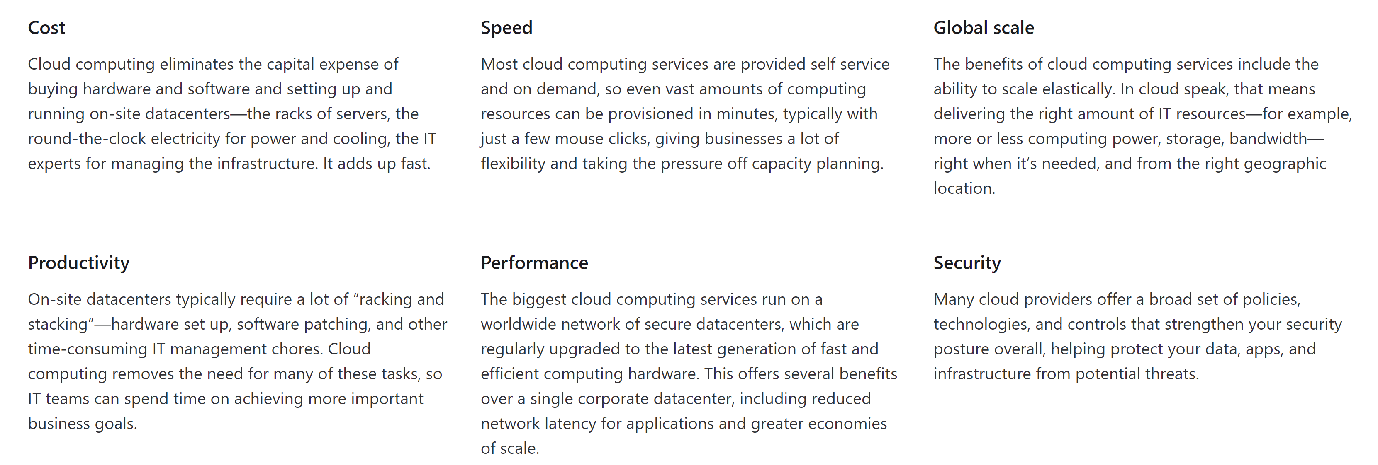
Top Benefits of Cloud Computing

Slide 5
Types of Clouds
Public Cloud
Private Cloud
Hybrid Cloud
Owned and operated by third-party cloud service providers
Deliver computing resources like servers and storage over the internet
Owned exclusively by a single business or organization
Can be physically located on the company's on-site datacenter
Could also be hosted by a third-party service provider, but maintained by the organization on a private network
Somewhere in the middle of public and private
Bound by technologies that allows data and applications to be shared between them
Most flexible option as it allows for a broad range of deployment options
Most control over security and compliance

Slide 6
Types of Cloud Services
PaaS
Services that provide on-demand environments for developing, testing, delivering, and managing software applications
No (less) need to manage underlying infrastructure
SaaS
Software
Delivery of software applications over the internet
Serverless
Overlaps with PaaS
Focuses on building app functionality without spending time managing the servers and infrastructures required to do so
IaaS
Most basic form of cloud computing services
Rent IT infrastructure
Includes:
VMs, Storage, Networks, Operating Systems
Infrastructure
Platform
Usually as an on-demand/subscription basis
Cloud provider hosts and manages the software application and underlying infrastructure
Usually highly-scalable and event-driven

Slide 7
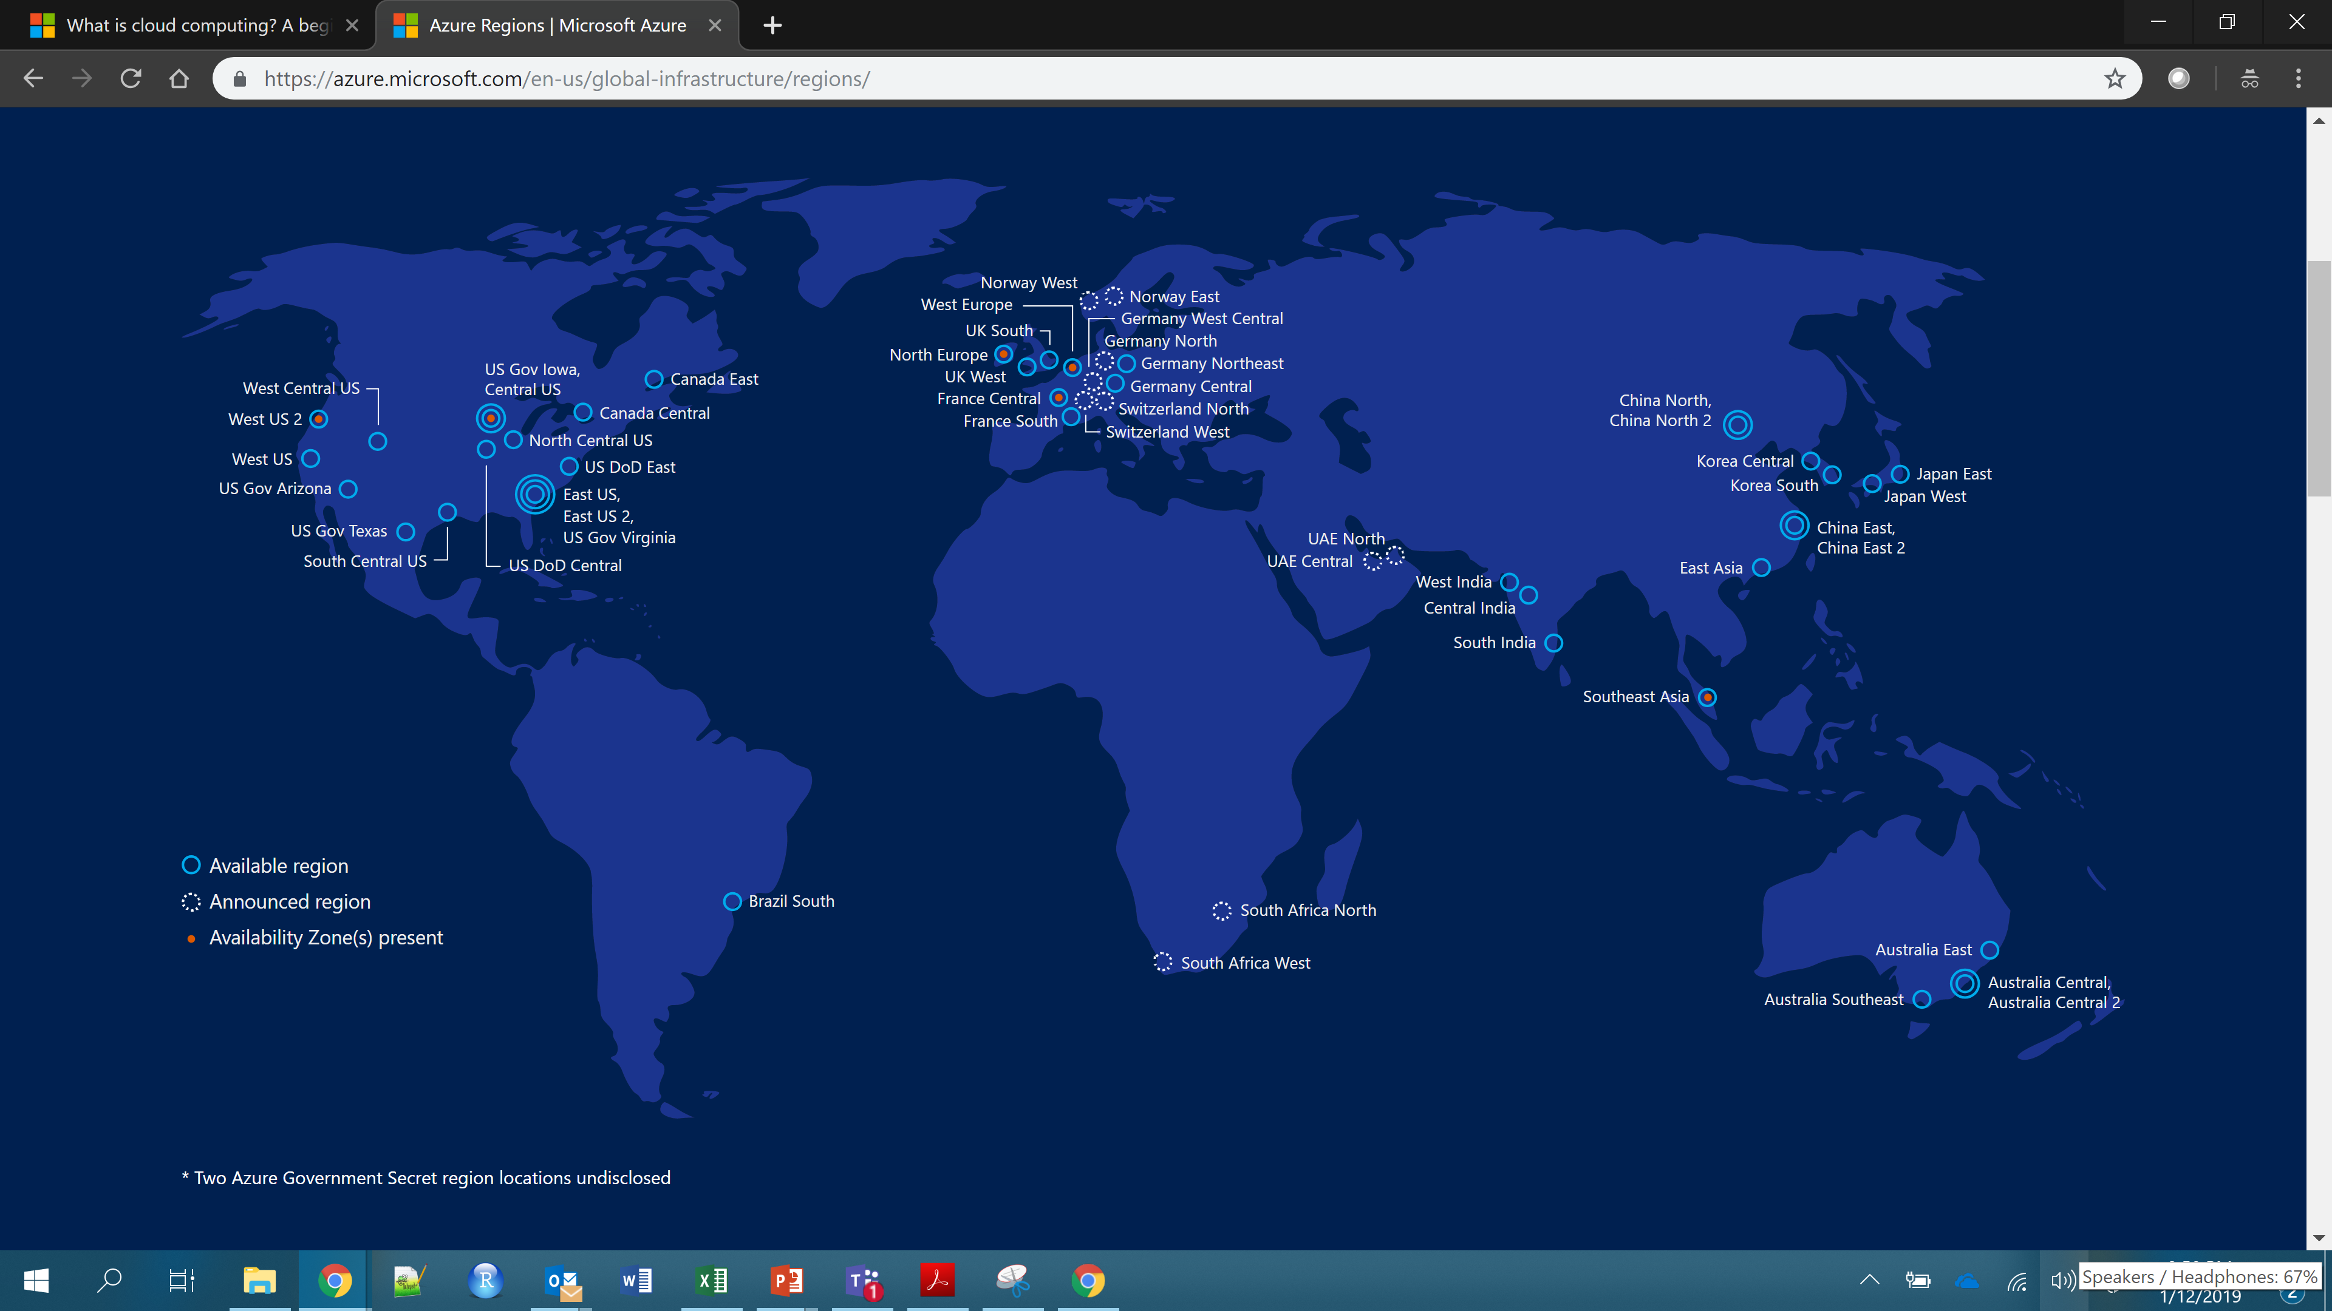
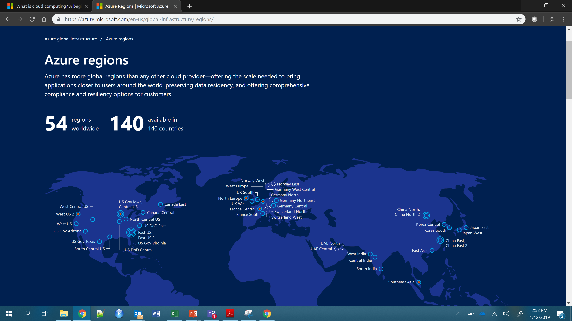
Azure Regions

Slide 8
Reasons to Select a Region
Speed
Pick a region that is the closest to you will help increase the speed of moving data in and out from your resources.
Cost
You will face egress fees if you move data from one region to another. So, it's cheaper for you to have everything nearby.
Some services are cheaper in certain regions over others. Using the Azure calculator can help you estimate the cost differences.
Available Resources
Certain services are only available in certain regions. It might not be possible to have everything in the same place. (See Products by Region.)
Security and Compliance
Depending on the scenario, a particular data center might need to be selected for security and compliance reasons. (Such as government or China)

Slide 9
Available Service Categories
AI + Machine Learning
Analytics
Compute
Containers
Databases
Developer Tools
DevOps
Identity
Integration
Internet of Things
Management and Governance
Media
Migration
Mobile
Networking
Security
Storage
Web
https://azure.microsoft.com/en-us/services/

Slide 10
Azure SQL Database
Azure SQL Data Warehouse
Other SQL-based Offerings
Structured Data Storage

Slide 11
Databases vs. Data Warehouses
Databases:
Usually for record-keeping of transactional systems
OLTP – Online Transactional Processing
Usually for a single application (personnel database, EMR, POS, etc.)
Focused on performance
Relational Schema
Highly normalized tables
Both:
Have multiple tables connected by keys
Use the same data types, indices, etc.
Can use views
Can be run on Azure SQL DB or Azure SQL DW
Data Warehouses:
Usually for keeping organizational historical data
OLAP – Online Analytical Processing
Usually for multiple systems combined
Focused on aggregation
Star or Snowflake Schema
Dimensions and Facts

Slide 12
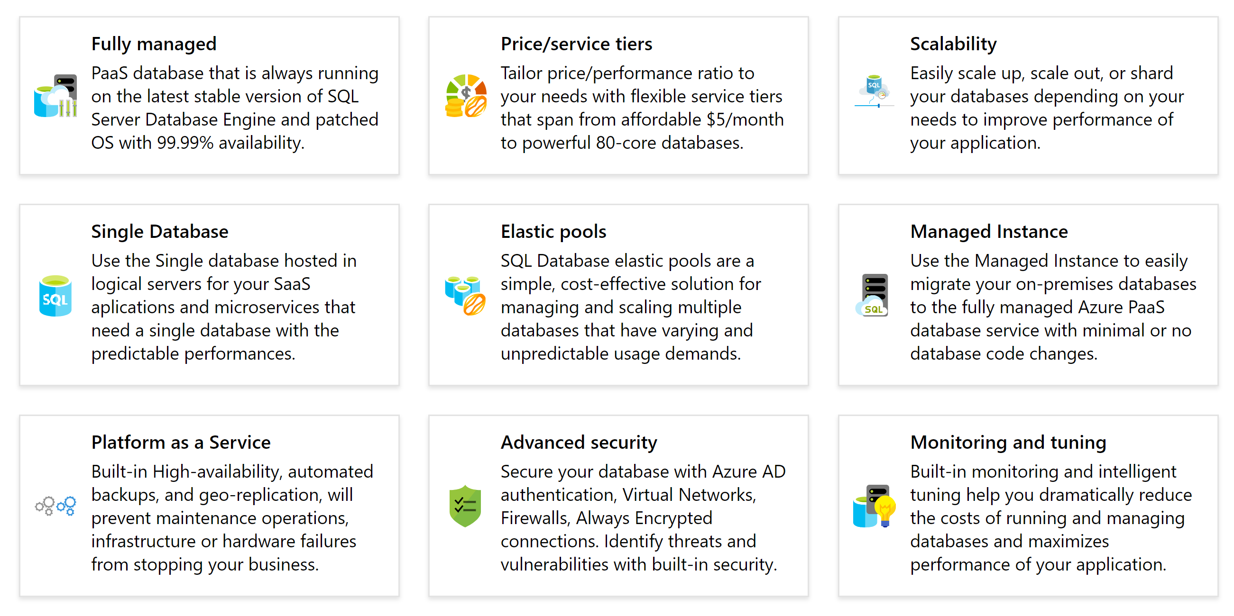
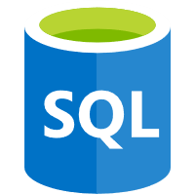
Azure SQL Database
Azure SQL Database is a relational database-as-a-service (DBaaS) based on the latest stable version of Microsoft SQL Server Database Engine. SQL Database is a high-performance, reliable, and secure database you can use to build data-driven applications and websites in the programming language of your choice, without needing to manage infrastructure.
https://docs.microsoft.com/en-us/azure/sql-database/

Slide 13
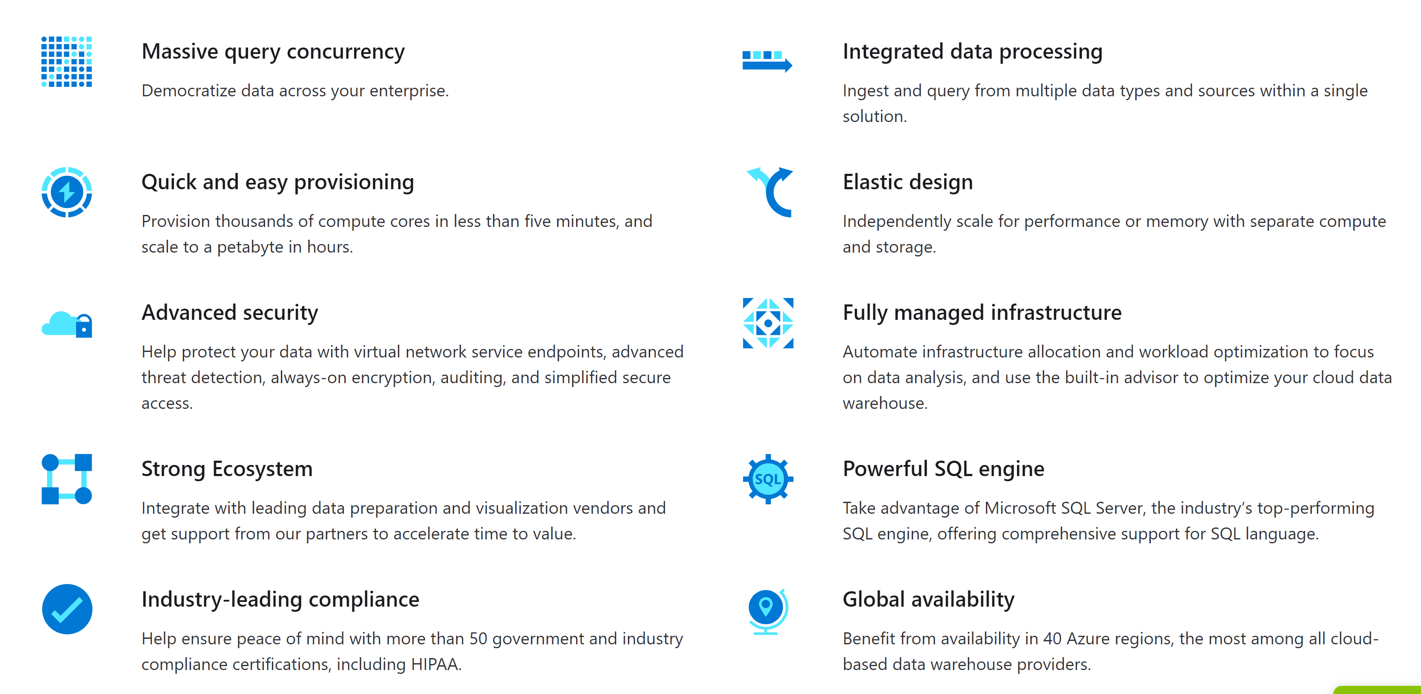
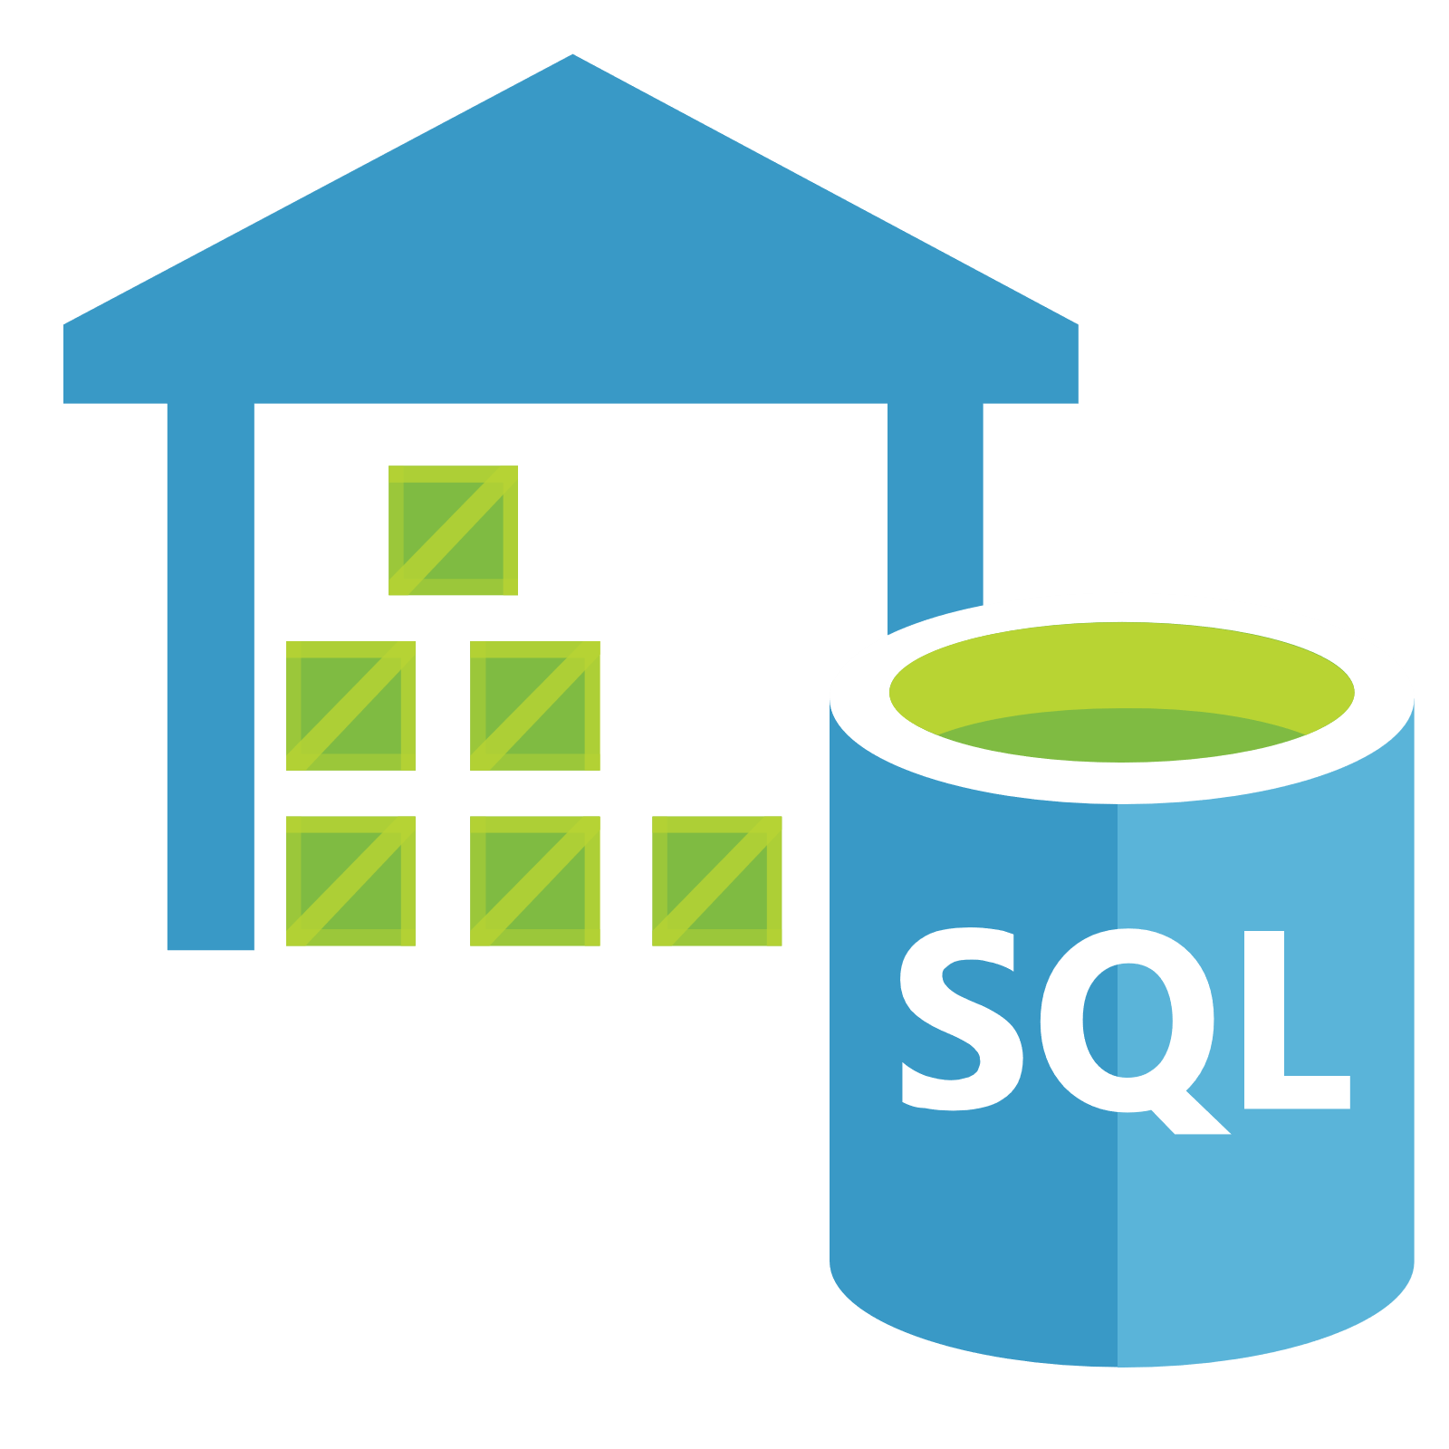
Azure SQL Data Warehouse
SQL Data Warehouse is a cloud-based Enterprise Data Warehouse (EDW) that leverages Massively Parallel Processing (MPP) to quickly run complex queries across petabytes of data. Use SQL Data Warehouse as a key component of a big data solution. Import big data into SQL Data Warehouse with simple PolyBase T-SQL queries, and then use the power of MPP to run high-performance analytics.
https://docs.microsoft.com/en-us/azure/sql-data-warehouse/

Slide 14



What is Polybase?
PolyBase enables your SQL instance to process T-SQL queries that read data from an external data source such as Azure Storage locations as an "external table".
https://docs.microsoft.com/en-us/sql/relational-databases/polybase/polybase-guide?view=sql-server-2017
https://docs.microsoft.com/en-us/sql/relational-databases/polybase/polybase-versioned-feature-summary?view=sql-server-2017

Slide 15
Just because you need to create a data warehouse, you may not need to you use Azure SQL Data Warehouse. -But Why?

Slide 16
Azure SQL DB vs. Azure SQL DW
Capability | Azure SQL Database | Azure SQL Data Warehouse
Data type | Relational | Relational
Active geo-replication | Yes | No
Dynamic Data Masking | Yes | No
Data Encryption at rest | Yes | Yes
Polybase T-SQL queries | No | Yes
Automatic Tuning | Yes | No
Massive Parallel Processing (MPP) | No | Yes
Ability to pause and resume | No | Yes
Max amount of data per database | 4TB | 1PB
Max concurrent open sessions | 30000 | 1024
Max concurrent queries | 6400 | 32
https://stackify.com/azure-sql-database-vs-warehouse/
https://docs.microsoft.com/en-us/azure/sql-data-warehouse/sql-data-warehouse-service-capacity-limits

Slide 17
Begin lab…

Slide 18
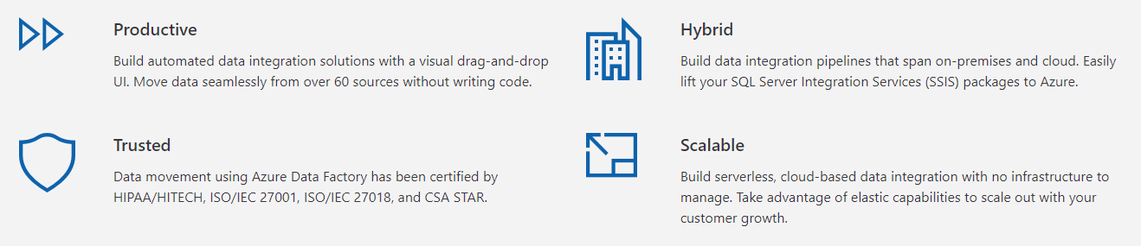

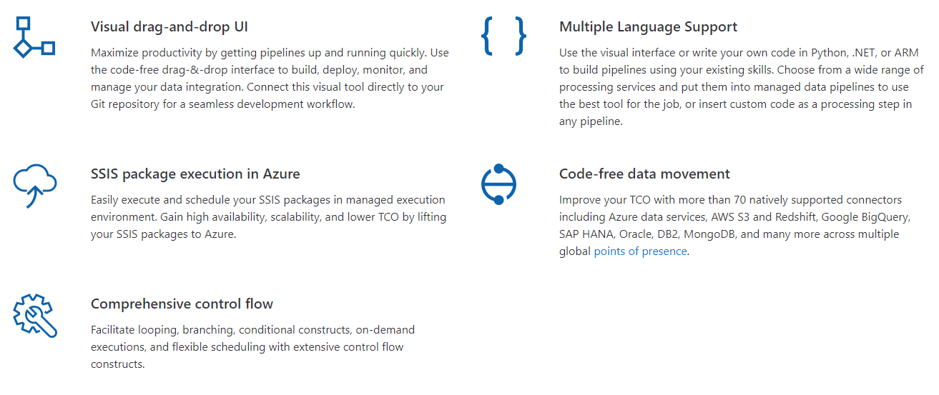
Azure Data Factory
Azure Data Factory is a cloud-based, hybrid data integration tool for creating data pipelines at scale. Complete with 70 data sources connectors and a slick UI, think of Data Factory as SSIS in the cloud.
https://docs.microsoft.com/en-us/azure/data-factory/

Slide 19
Azure Storage
Azure Data Lake Store
Unstructured Data Storage

Slide 20

Azure Storage
File Simple, distributed, cross-platform file system Lift and shift migration Simple and inexpensive Move data to cloud with no coding | Disk Persistent, high-performance disk storage for every workload Low latency, high throughput Industry-leading, single-instance service-level agreement Enterprise-grade durability | Blob Massively-scalable object storage for unstructured data Cost-effective for massive volume Tiered storage options Single infrastructure with global reach
 | Archive Industry leading price point for storing rarely accessed data Data automatically encrypted at rest Seamless integration with hot and cool storage tiers Supported by leading Data Management partners | Data Lake Storage Secure, massively scalable data lake storage. Limitless storage for analytics data Optimized for Apache Spark and Hadoop analytics engines High-performance file system with support for fine-grained access control lists
Azure Storage provides cloud storage that is highly available, secure, durable, scalable, and redundant. Azure Storage includes Azure Blobs (objects), Azure Data Lake Storage Gen2, Azure Files, Azure Queues, and Azure Tables.
https://azure.microsoft.com/en-us/services/storage/?v=18.24

Slide 21
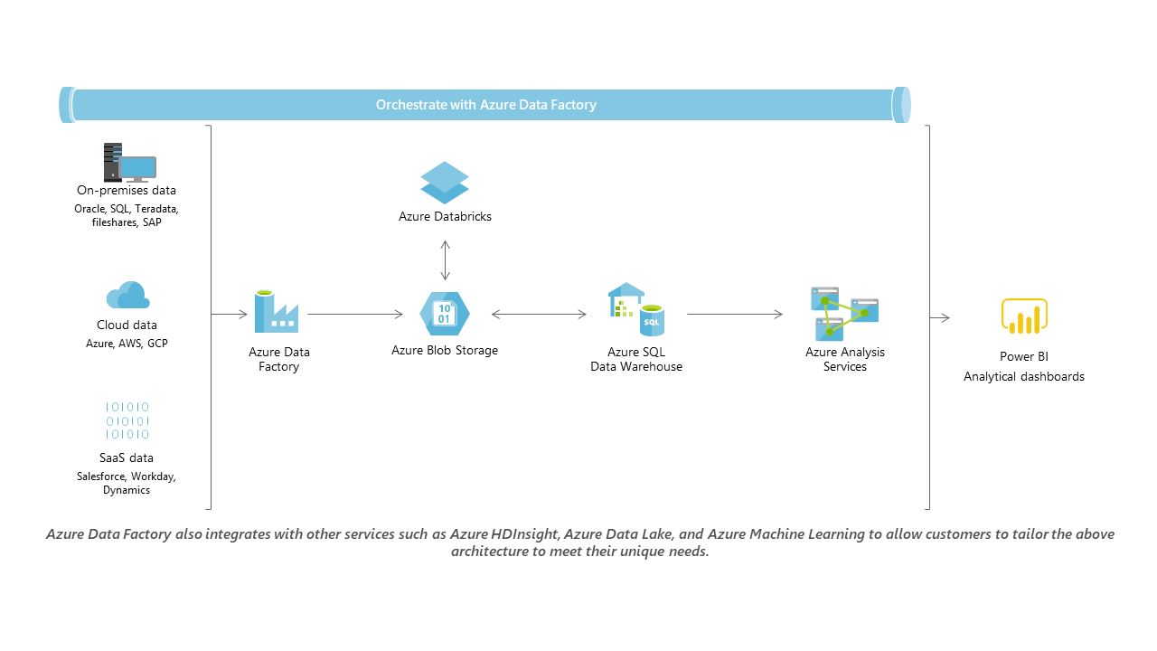
https://docs.microsoft.com/en-us/azure/architecture/data-guide/

